Slide 1


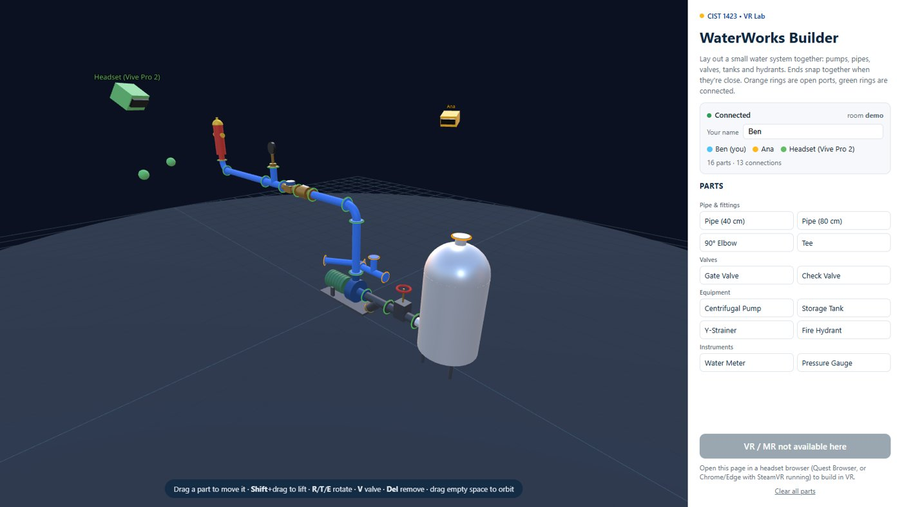

Virtual Reality
WebXR Building: a multiplayer water-system builder (replaces AR Development II)
Wednesdays at 6:00pm
CIST 1423 - 2010 VIRTUAL REALITY PROGRAMMING AND TECHNOLOGY
Run it: cd Week-07-WebXR-WaterWorks && npm install && npm start
Notes:
Syllabus Week 7 was AR Development in Unity II. Replaced with WebXR building. Part 1 (Sneaker Builder → Panther) is the other Week 7 deck. Exam 2 (Ch. 3–4) is still this week.

Slide 2
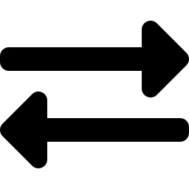


Agenda
AR II → WebXR
Building WaterWorks
Going multiplayer
Plane detection, placement, anchors: now in the browser
Parts, ports, snapping, the workspace
A WebSocket relay with rooms and ownership

Slide 3

Today
By the end of class you can…
Map plane detection / raycast / anchors between AR Foundation and WebXR
Tonight's plan
1
0–5
Collect reading answers
Explain the ECS pattern: components = data, systems = logic, order matters
2
5–40
Exam 2 (Ch. 3–4)
40–70
Part 1 recap + AR II → WebXR
Tell a codebase's engine layer from its product layer
3
70–80
Live demo: 3 devices, 1 room
Run a multi-device WebXR session and build a water system as a team
80–135
Lab: teams of 3 build a system
4
135–150
Share-out + exit ticket
CIST 1423 — Week 7 — WebXR Building: WaterWorks Builder
Notes:
Full lesson plan: Lesson-Plans/Week-07-WebXR.md

Slide 4
Why WebXR instead of AR II
The AR II topics all exist in WebXR, and one build runs on every headset in the lab.
AR II topic (Ch. 4) | AR Foundation | WebXR (ratk + three.js)
Plane detection | ARPlaneManager | requiredFeatures: ['plane-detection'] → ratk planes
Touch / controller placement | ARRaycastManager.Raycast | 'hit-test' → XRHitTestSource
Anchors | ARAnchorManager | 'anchors' → XRAnchor
Testing | XR Simulation / device build | Immersive Web Emulator, desktop mode
Deploying | Android / iOS builds | One HTTPS URL, no store
Exam 2 (Ch. 3–4) is still this week. The AR concepts are on it; WebXR is how we practise them.
CIST 1423 — Week 7 — WebXR Building: WaterWorks Builder

Slide 5
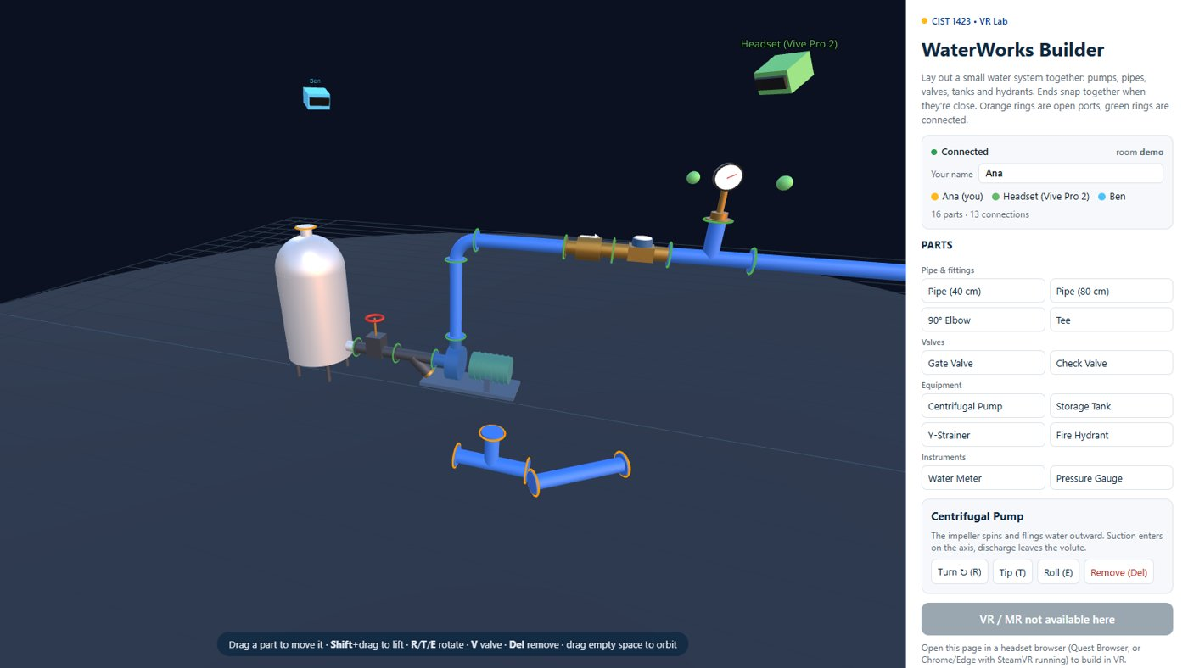
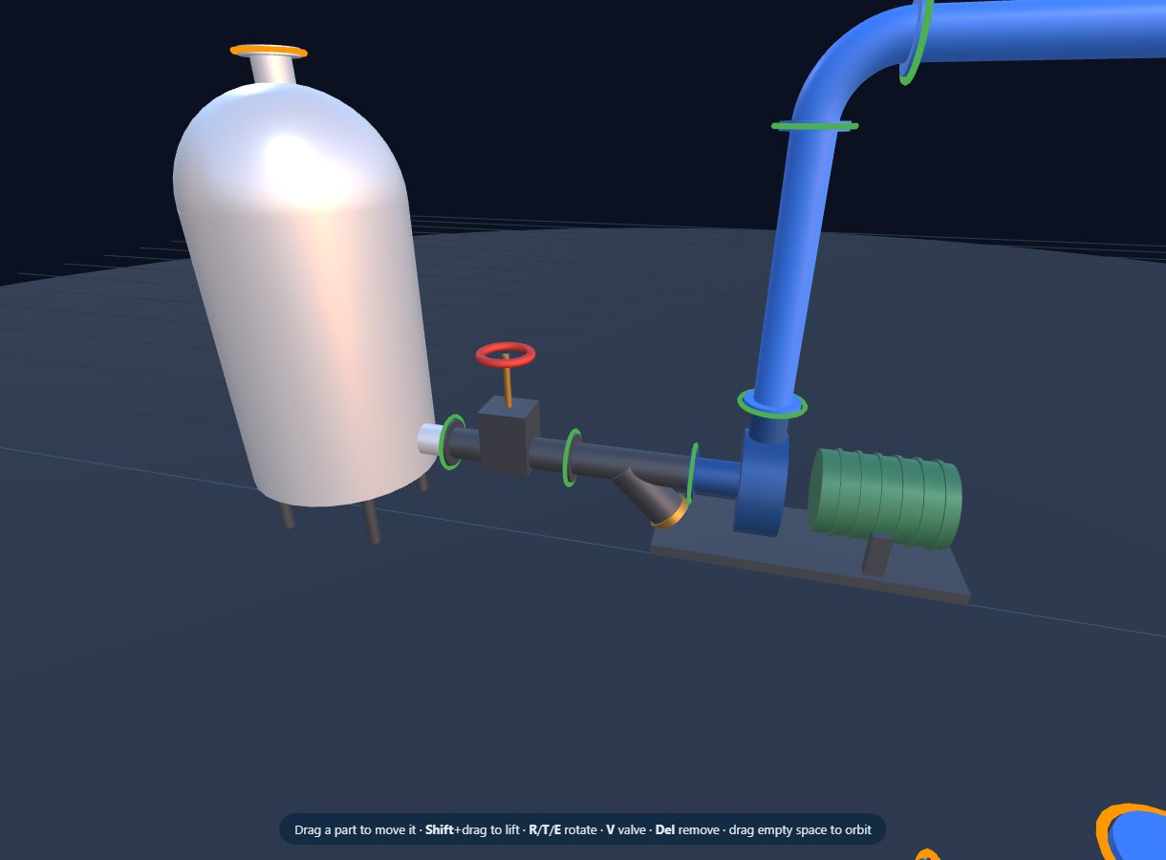
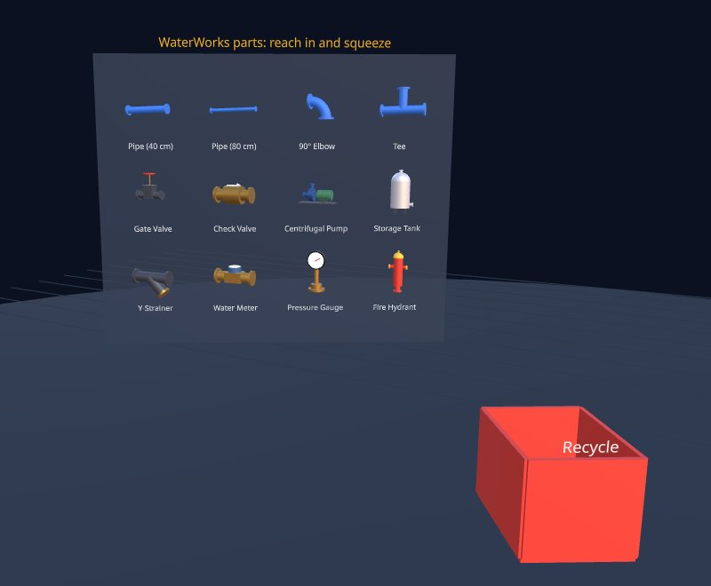
What we're building
Tank → valve → strainer → pump → riser → check valve → meter → tee + gauge → main → hydrant
Desktop builder: palette, part info, people in the room
Ports snap together: green = connected, orange = open
In the headset: reach into the shelf and pull out a part
CIST 1423 — Week 7 — WebXR Building: WaterWorks Builder

Slide 6
Fork again: panther-builder → WaterWorks
The engine layer came along untouched; the product layer is new.
File | Status | What it does
player / pointer / follow / audio / global / scene | unchanged | Controllers, claw/ray pointer, lazy-follow UI, spatial audio, loaders, lights
parts.js | new | 11 water-system parts from three.js primitives; each has ports {pos, dir}
snap.js | new | Find the nearest facing port, then rotate + slide to meet it (pure maths, unit-tested)
workspace.js | new | Every part by id: the one place parts are added / moved / removed
grab.js | generalised | Many parts, shelf spawners, recycle bin, network ownership
shelf.js / desktop.js | new | In-headset shelf + ray clicks; mouse building + HTML page
network.js / avatars.js | new | WebSocket client (offline-first) + other people's heads and hands
CIST 1423 — Week 7 — WebXR Building: WaterWorks Builder

Slide 7


Parts are code, not model files
parts.js: each builder returns a Group plus its connection ports.
function gateValve() {
const g = new Group();
const iron = mat(COLORS.iron, 0.6, 0.4);
g.add(xCylinder(PIPE_R, 0.24, iron)); // the pipe body
g.add(flangeX(-0.12, iron), flangeX(0.12, iron));
const wheel = new Mesh(new TorusGeometry(0.045, 0.008, 8, 24),
mat(COLORS.valveRed));
wheel.position.y = 0.19;
wheel.name = 'handwheel'; // shelf.js ray-clicks this
g.add(wheel);
return {
group: g,
ports: [port([-0.12, 0, 0], [-1, 0, 0]), // position + outward direction
port([ 0.12, 0, 0], [ 1, 0, 0])],
};
}
Ports
Every connection point: local position + outward direction
Tests check each port is on the geometry and faces out
Add a part type
Write a builder, add it to PART_TYPES
Shelf, palette, snapping and networking pick it up automatically
CIST 1423 — Week 7 — WebXR Building: WaterWorks Builder

Slide 8


Snapping: two lines of quaternion maths
snap.js. Released near an open port? Turn to face it, then slide until the ports touch.
// 1) rotate so my port points exactly opposite the target port
const align = new Quaternion()
.setFromUnitVectors(mine.dir, target.dir.clone().negate());
moving.quaternion.premultiply(align);
// 2) slide so the two port centres coincide
moving.updateMatrixWorld(true);
const myPortNow = localPort.pos.clone().applyMatrix4(moving.matrixWorld);
moving.position.add(target.pos.clone().sub(myPortNow));
// only if close (< 12 cm) and roughly facing (dot < -0.5)
Tested in Node
Two pipes snap end to end
A turned elbow ends up exactly facing
Ports pointing the same way never snap
Unity equivalent
Quaternion.FromToRotation(a, b) * transform.rotation
Same maths, different names
CIST 1423 — Week 7 — WebXR Building: WaterWorks Builder

Slide 9

Lab: run it in the VR Lab
One PC runs the server; every headset and laptop opens the same URL.
1. Install
2. Serve
3. Quest
4. Vive Pro 2
5. Laptops
cd Week-07-WebXR-WaterWorks
npm install
npm test (25 tests)
npm start
Prints https://<PC-IP>:8443 for each network adapter
Quest Browser → URL → accept cert → Build in Mixed Reality
Start SteamVR, open the URL in Chrome/Edge → Build in VR
Same URL. Drag to build; R/T/E rotate; ?room=team3 for your own room
GitHub Pages?
Static hosting can't run the relay. The page falls back to single-player, or point it at a relay with ?server=wss://…/ws
CIST 1423 — Week 7 — WebXR Building: WaterWorks Builder

Slide 10
Check your understanding
Answer with a partner first, then we'll compare.
Q1
Q2
Name one engine-layer and one product-layer file in WaterWorks.
Two ports won't snap. Give two reasons.
Q3
Q4
Why does one URL work on both a Quest and a Vive Pro 2?
What does the server send a late joiner?
CIST 1423 — Week 7 — WebXR Building: WaterWorks Builder
Notes:
Answers:
Q1. Name one engine-layer and one product-layer file in WaterWorks.
Engine: player.js, pointer.js, follow.js, audio.js, global.js. Product: parts.js, snap.js, workspace.js, shelf.js…
Q2. Two ports won't snap. Give two reasons.
More than 12 cm apart, or not roughly facing each other (dot of directions must be below -0.5).
Q3. Why does one URL work on both a Quest and a Vive Pro 2?
The page checks immersive-ar, then falls back to immersive-vr, and AR features are optional.
Q4. What does the server send a late joiner?
A welcome snapshot: everyone in the room and every part with its pose, state and holder.

Slide 11

Next steps: homework + planning
In teams of 3: build tank → pump → hydrant in one room, with each person in a different device
Screenshot it and push a Markdown write-up: who built what, what snapped, what didn't
Stretch: add one new part type (reducer, elbow 45°, backflow preventer) with ports
Exam 2 covers Ch. 3–4
CIST 1423 — Week 7 — WebXR Building: WaterWorks Builder

